Slide 1

Creating calculated columns & measures in DAX

Slide 2
Measures and DAX (Data Analysis Expressions)
In Power BI and other data analysis tools that support DAX (Data Analysis Expressions), calculated columns and measures are essential for custom calculations and data manipulation. Measures and DAX (Data Analysis Expressions) are foundational to performing advanced data analysis in Power BI. DAX is a robust formula language that allows users to create dynamic, real-time calculations that respond to filters and context within reports.

Slide 3
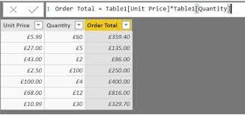
1. Calculated Columns
Calculated columns are created by adding new columns to a table with a calculation applied to each row. The calculation is done at the row level, which means it considers each row independently.
Example:
If you have a table for SALES AND QUANTITY AND PRICE and you want a calculated column for TOTAL SALES you can create it like this:
Total Sales = Sales[Quantity] * Sales[Price]
This column will display the total sales for each row.

Slide 4
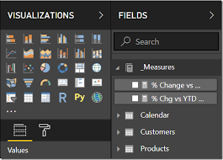
2. Measures
Measures are aggregations calculated based on user interactions and filters applied in the report. They are calculated dynamically and are usually displayed in visuals such as charts or tables.
Example:
Using the same SALES table, if you want to calculate the total revenue (sum of all TOTAL_SALES values), create a measure:
Total Revenue = SUM(Sales[Total Sales])

Slide 5
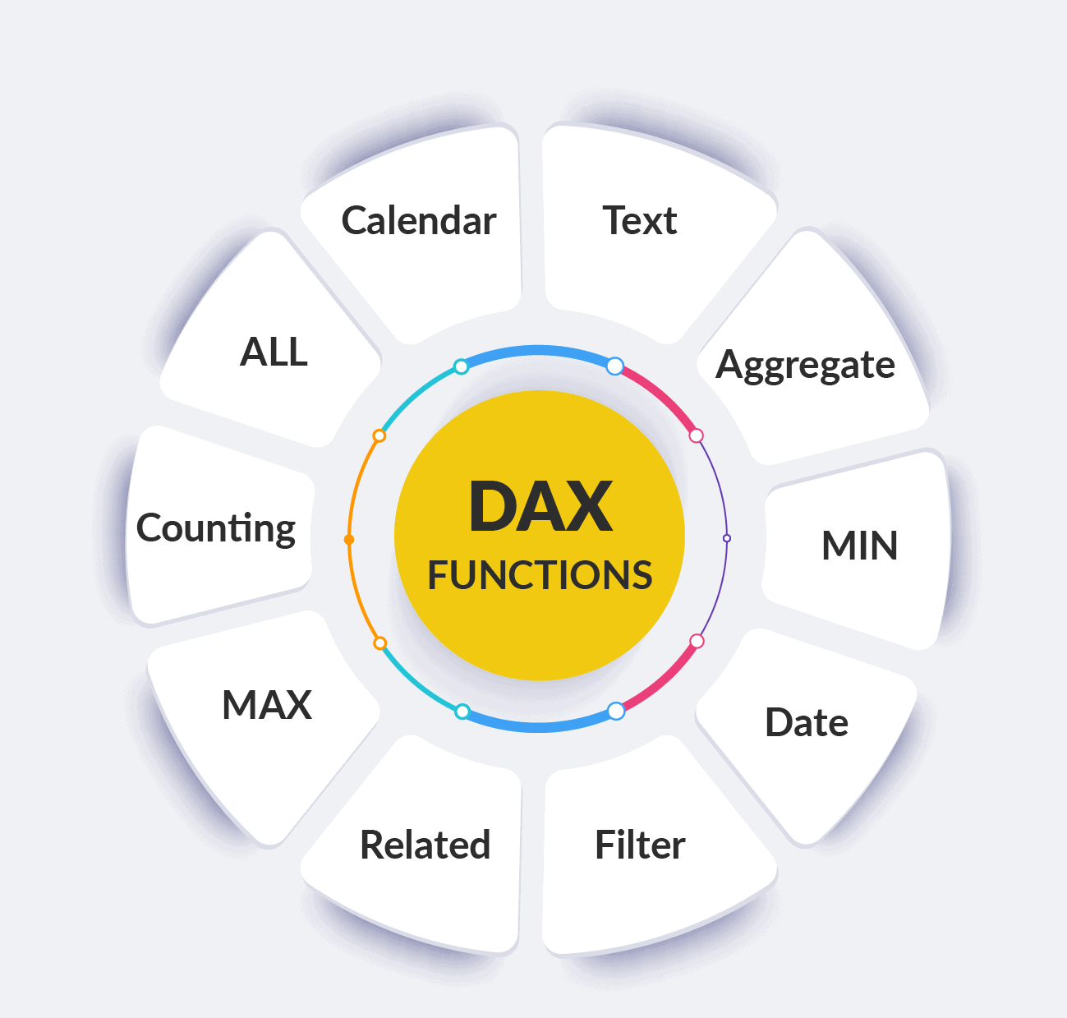
Useful DAX Functions
1. Aggregation Functions
SUM() : Adds all the numbers in a column
Total Sales = SUM(Sales[Amount])
AVERAGE(): Returns the average of all the numbers in a column
Average Sales = AVERAGE(Sales[Amount])
COUNT(): Counts the number of rows in a column that contains numbers.
Number of Orders = COUNT(Sales[OrderID])

Slide 6

2. Logical Functions
IF(): Returns one value if a condition is TRUE, and another if it is FALSE.
High Sales = IF(Sales[Amount] > 1000, "High", "Low")
SWITCH(): Evaluates an expression against multiple values and returns the first matching value
Category = SWITCH(TRUE(), Sales[Amount] > 1000, "High", Sales[Amount] > 500, "Medium", "Low")

Slide 7
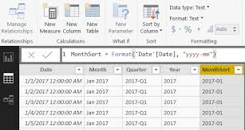
3. Date and Time Functions
DATE(): Returns the current date
TodayDate = TODAY()
YEAR(): Extracts the year from a date
Year = YEAR(Sales[OrderDate])

Slide 8

4. Filter Functions
CALCULATE(): Evaluates an expression in a modified filter context
Sales for 2024 = CALCULATE(SUM(Sales[Amount]), Sales[Year] = 2024)
FILTER(): Returns a table that represents a subset of another table
Filtered Sales = FILTER(Sales, Sales[Amount] > 1000)

Slide 9

5. Text Functions
CONCATENATE(): Joins two text strings into one.
Full Name = CONCATENATE(Sales[FirstName], Sales[LastName])
FORMAT(): Formats a number or date as a string
Formatted Date = FORMAT(Sales[OrderDate], "MM/DD/YYYY")

Slide 10

6. Math and Trigonometric Functions
ROUND(): Rounds a number to the specified number of digits
Rounded Value = ROUND(Sales[Amount], 2)
DIVIDE(): Divides two numbers, handling divide-by-zero errors
Profit Margin = DIVIDE(Sales[Profit], Sales[Amount])

Slide 11
Conclusion
In conclusion, mastering measures and DAX is crucial for unlocking Power BI’s full potential, enabling users to derive deep insights from their data with precise, context-sensitive, and efficient calculations.

Slide 12


Thank you
ajaycraju98@gmail.com

